Slide 1
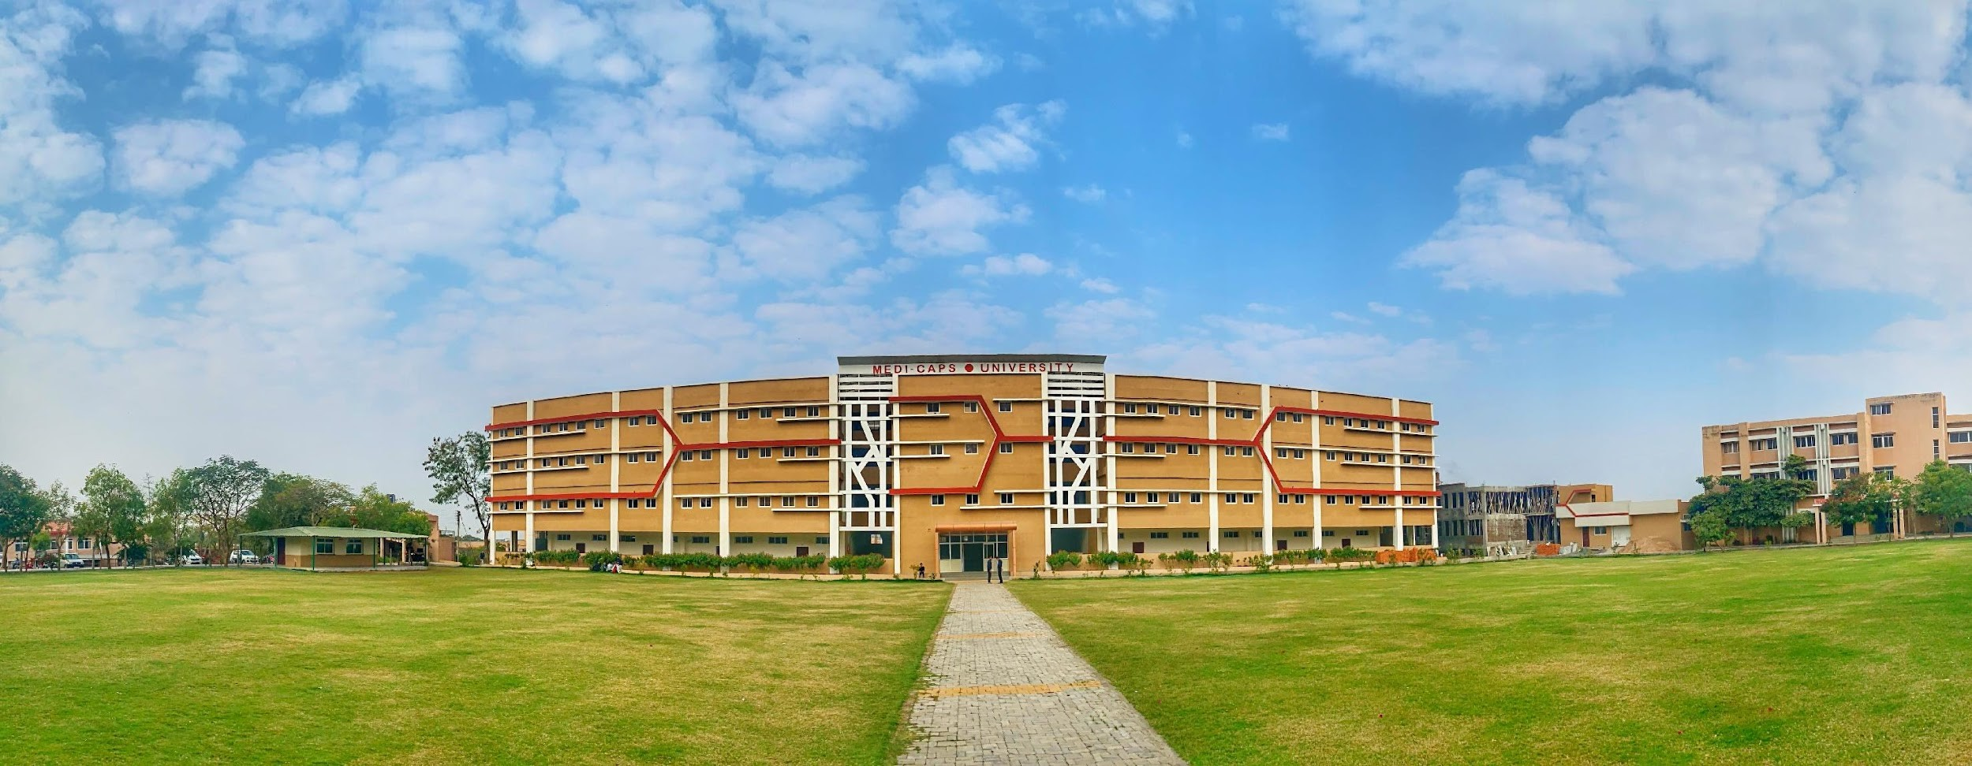
E - Commerce
A Project Report Submitted at
Medi-Caps University, Indore
In partial fulfillment of the degree
of
Master of Computer Application
Submitted by:- Abhishek Sevarik
[EN20CA501007]
Goldi Verma
[EN20CA501052]
Honey Jain
[EN20CA501059]

Slide 2
MCA Department
Medi-Caps University Indore-453 331 Aug-Dec, 2021
Guided by :-
Mr. Anil Patidar

Slide 3
Introduction
By choosing an online ecommerce platform to create an online store, you can efficiently reduce the cost of managing and selling online. You have various opportunities to boost the efficiency of your service that eventually enhances the revenue earned.

Slide 4
Objective of Project :-
We are making a e-commerce site in which we are maintaining a different platforms in a single code base.

Slide 5
Problem definition :-
we are using an hybrid approach in which we are using a different-different platforms in a dynamic themes and single code base maintained with the help of this approach development was easy and fast.

Slide 6
Technology used
Software Requirements :-
Android studio
X-code
Web browser
Fire base
Fire store
Flutter ,provider, razorpay
Hardware Requirements:-
Mobile device
IOS device
browser

Slide 7
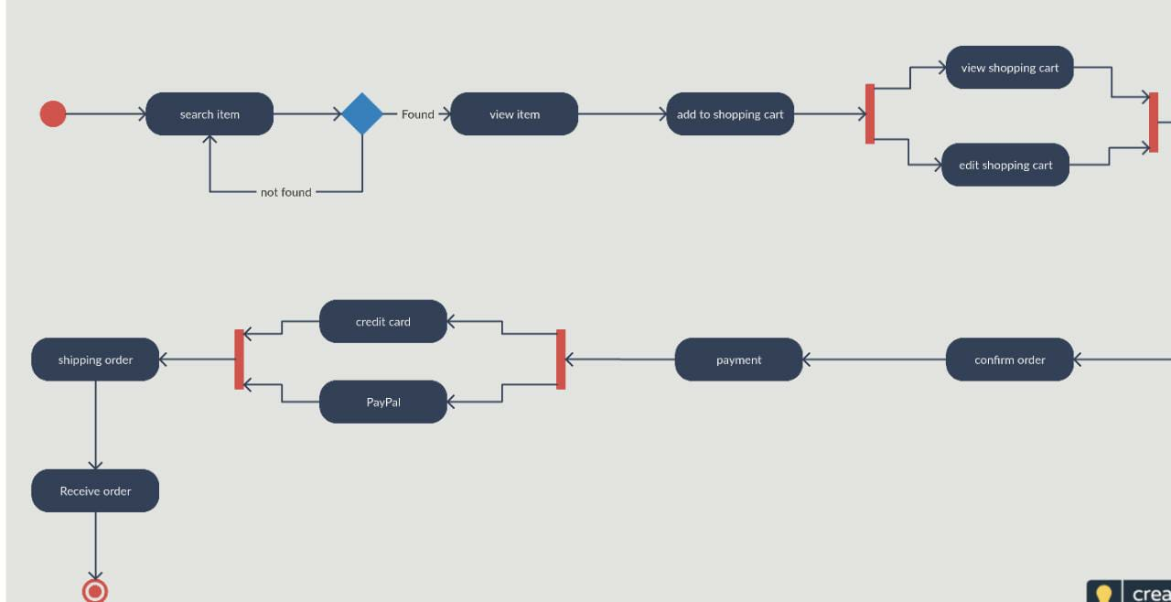
Functional Requirement
Third Party Integration :- Razorpay ,Provider Package, Firebase Auth , Firebase Firestore
Responsiveness:-Mobile friendly(able to adapt all the screen sizes),Web browser friendly
Product Attributes:-product_id,product_title,imageUrl,quantity,price,id
Feed Attributes:-imageUrl,ispopular,size,id,product_id,cart_id,quantity,color,title,description
Order and CheckoutFlow:-

Slide 8
Non Functional Requirements
Usablity:The main goal of any online store is to attract more potential buyers and increase sales with minimum expenses on advertising. The most important task is not to grow traffic but to improve the conversion of visitors into buyers. And better e-commerce usability is one of the trusted and secure methods to increase sales.
Security:for providing best in class security our app is hosted in firebase and it provides some real time threats monitoring and analytics to serve our customers a maximum security
Performance:EcommerceApp uses device native functionalities and uses optimal resources to keep our app performance in an optimal state
Maintainability:with the use of MVC architecture enables detection of bugs and fixes in an easy manner
Scalablity:With the use of categorization of files and folders it’s easy to scale the product and add features to it very easily

Slide 9
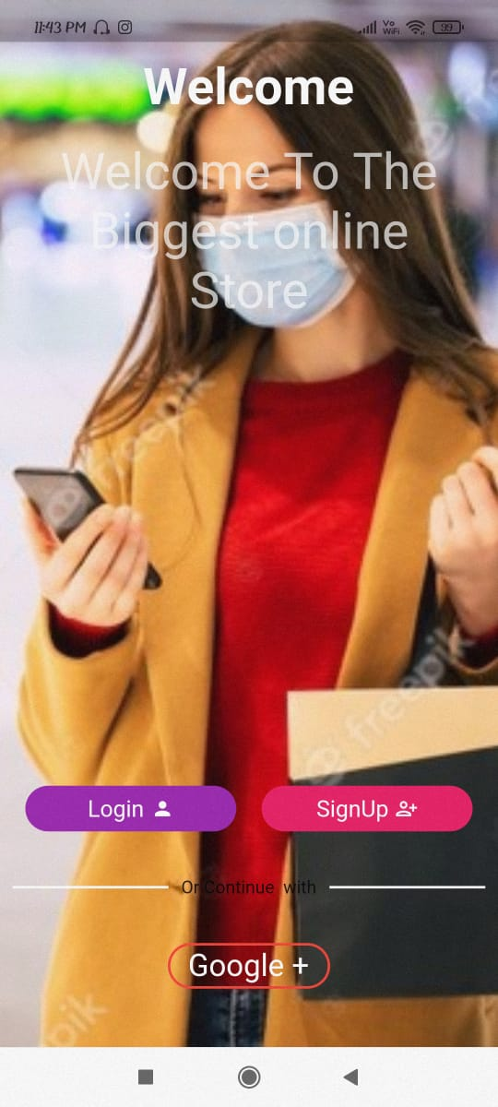
Diagrams
Login & Signup :-

Slide 10
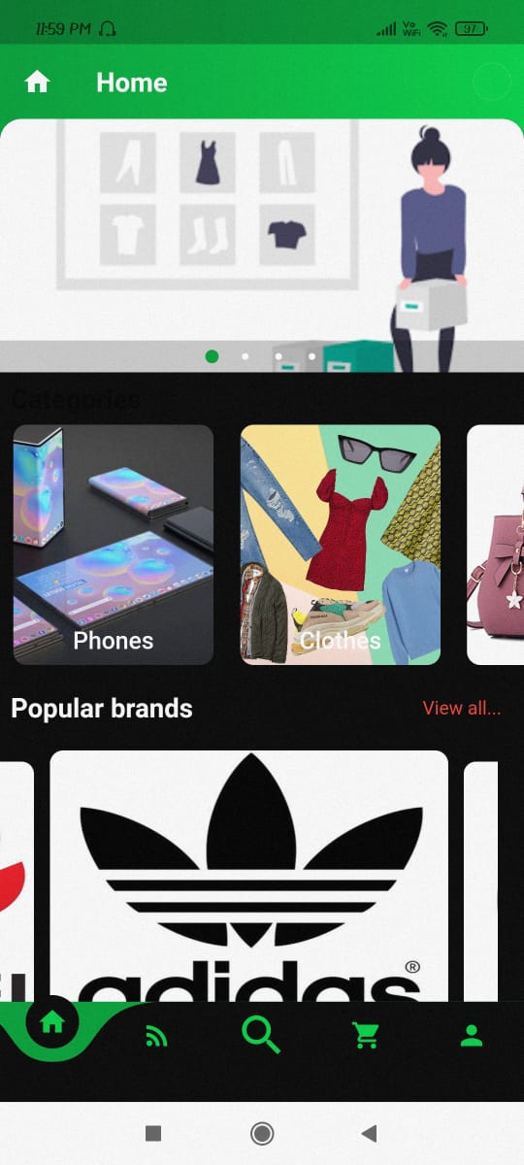
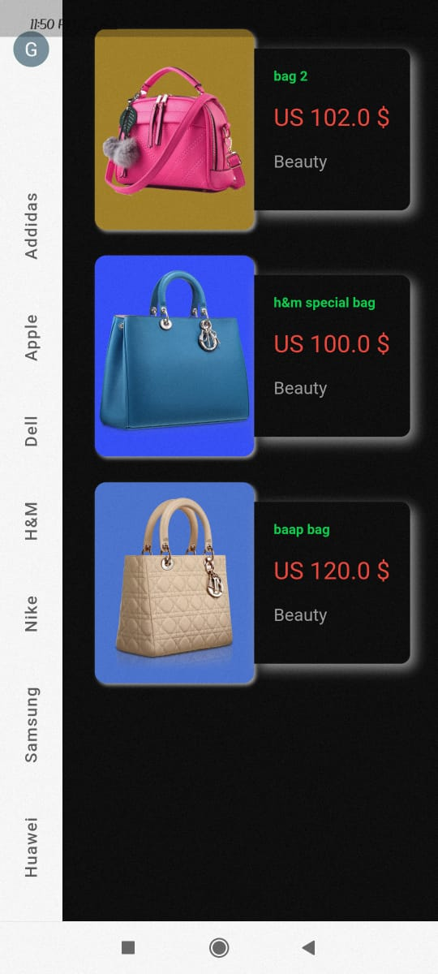
Wish-list management

Slide 11
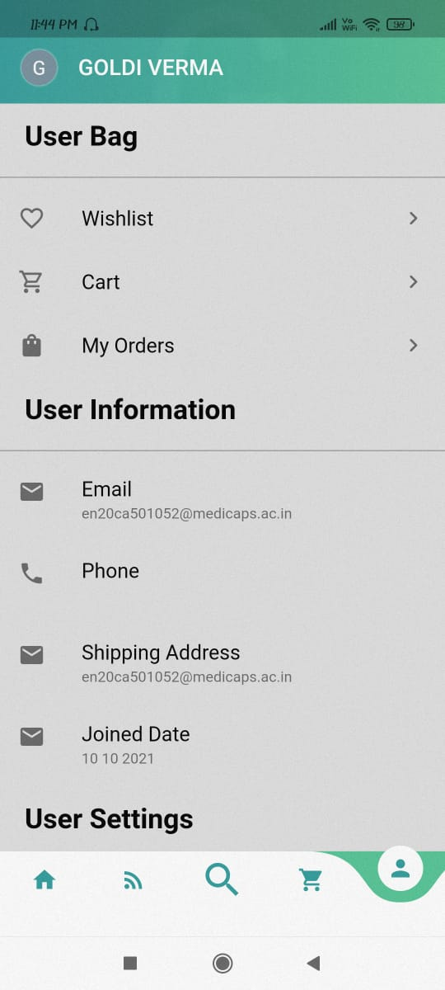
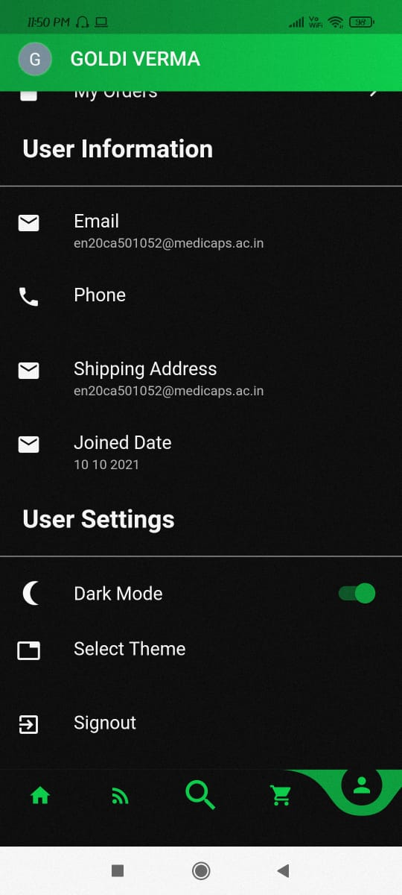
User profile
Dark mode

Slide 12
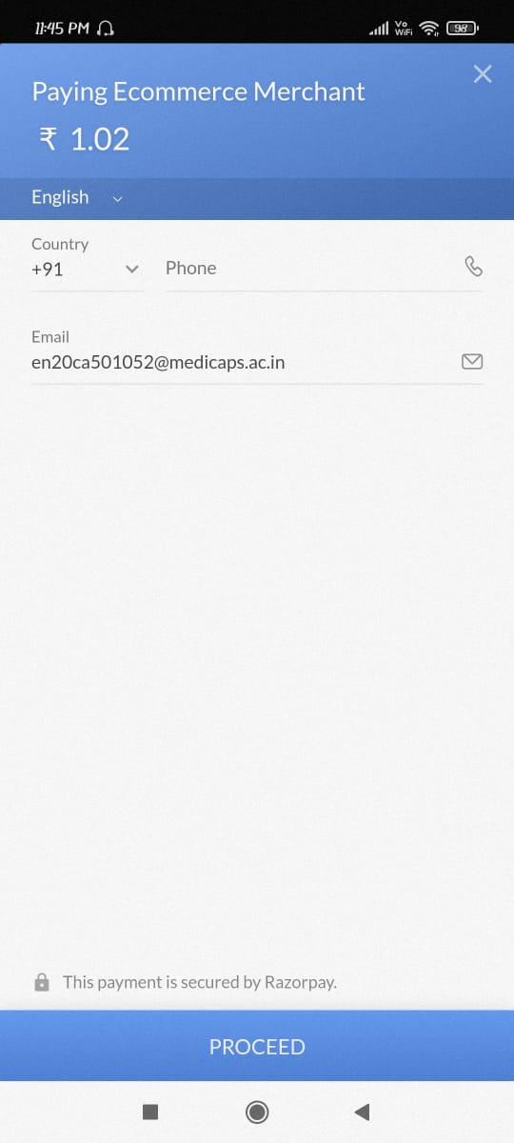
Payment management :-

Slide 13
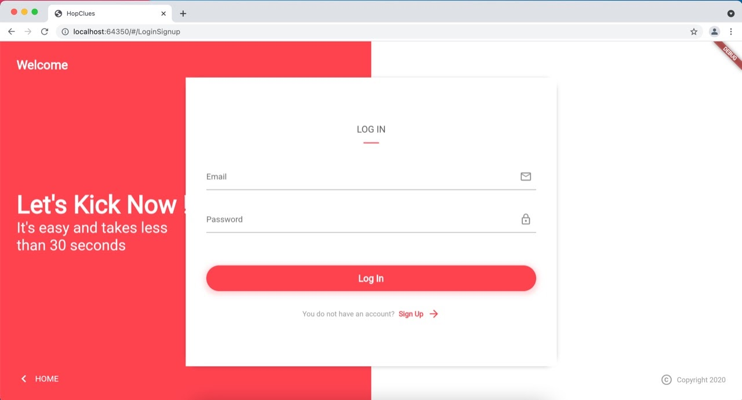
Web components(Log In)

Slide 14
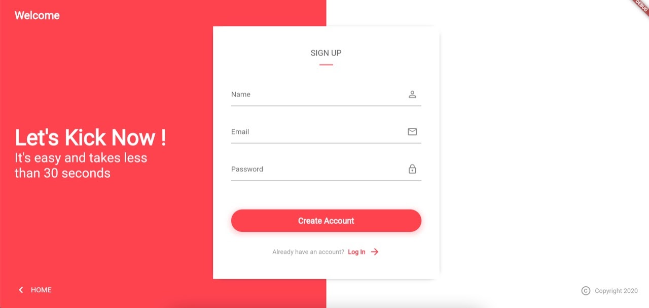
Sign Up

Slide 15
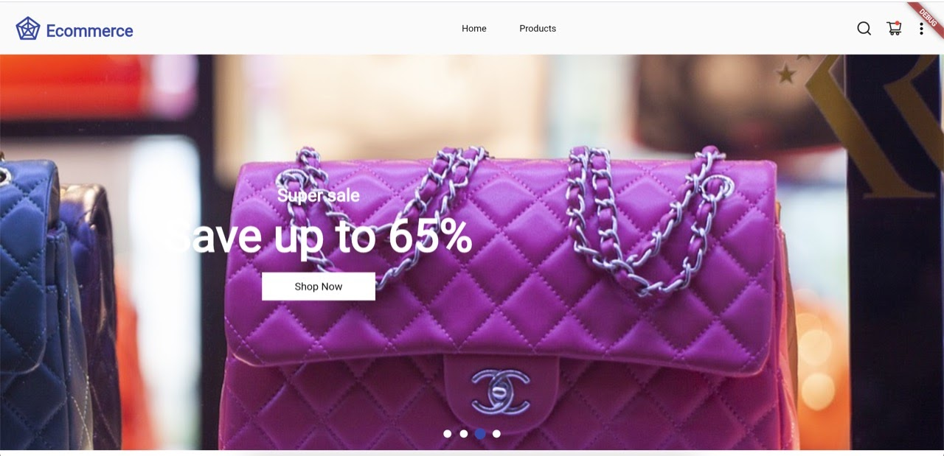
Home Page

Slide 16

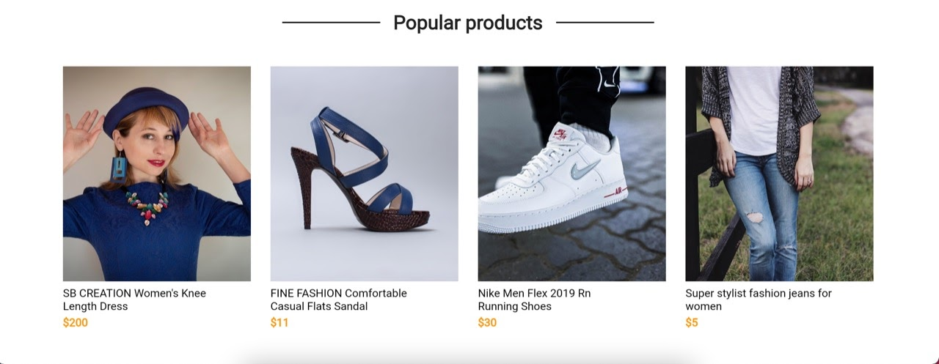

Slide 17
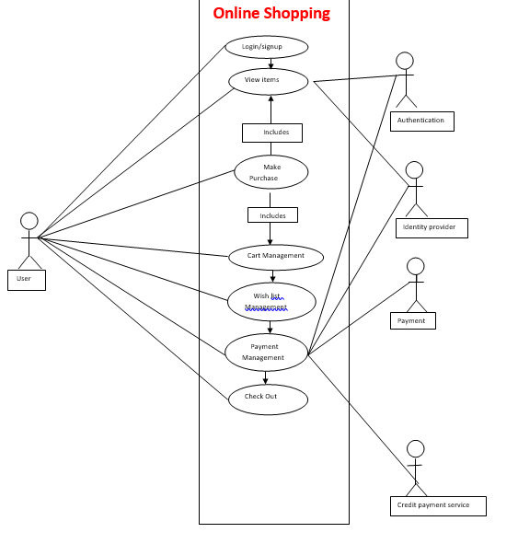
Use-case :-

Slide 18
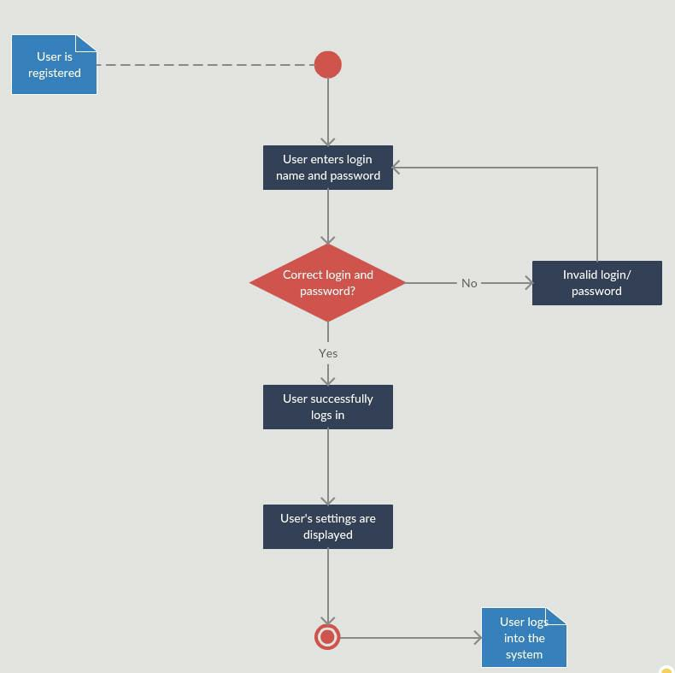
Activity
User login -

Slide 19
Online shopping system :-

Slide 20
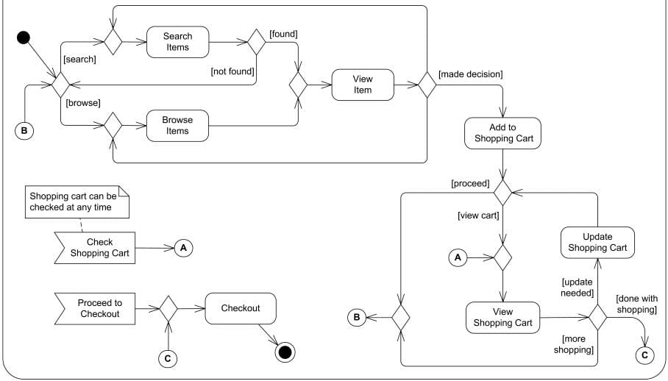
Cart management :-

Slide 21
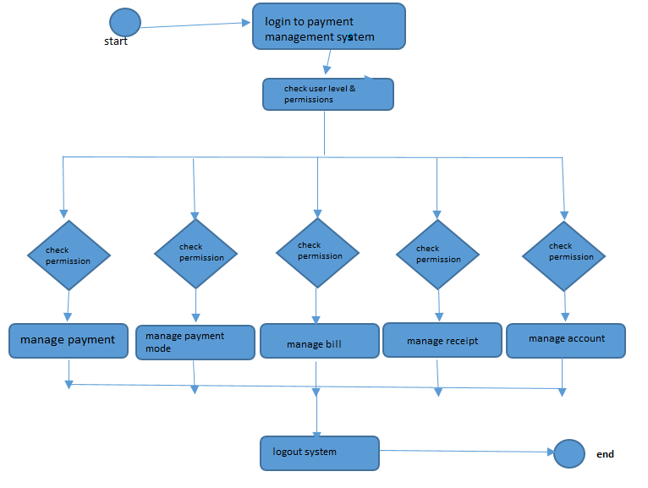
Payment management system

Slide 22
ER Diagram
Entity-Relationship Diagram:-
An entity-relationship (ER) diagram is a specialized graphic that illustrates the relationships between entities in a database. ER diagrams often use symbols to represent three different types of information. Boxes are commonly used to represent entities. Diamonds are normally used to represent relationships and ovals are used to represent attributes.

Slide 23
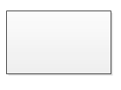
The Symbols are shown in below table:
Name | Notation | Description
Entity |  | Entity is represented by a box within the ERD. Entities are abstract concepts, each representing one or more instances of the concept in question. An entity might be considered a container that holds all of the instances of a particular thing in a system. Entities are equivalent to database tables in a relational database, with each row of the table representing an instance of that entity.

Slide 24

Relationship |  | Relationships are represented by Diamonds. A relationship is a named collection or association between entities or used to relate to two or more entities with some common attributes or meaningful interaction between the objects.

Slide 25

Attributes |  | Attributes are represented by Oval. An attribute is a single data item related to a database object. The database schema associates one or more attributes with each database entity.

Slide 26
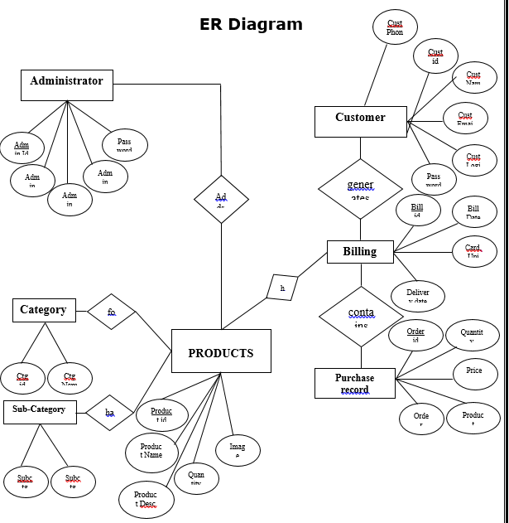

Slide 27
Limitations
E-Commerce products-shop have some limitations as this is the first application and implements on a very small scale.
User can only order Products from the Eshop which is by the admin side
Users must have proper internet connection to stay on our Website.
Users may face problems running the application in mobiles.
Users may face problems with the online Payment option.

Slide 28
Future Scope
We try to make this project available at large scale in future, for any location all over India(if possible).
We will implement the better search products without waist any time
In Future we try to make our platform more secure and make more efficient payment options.
The E-commerce products shop came up with the new idea and our aim is to cover all other products that come under the electronic appliances and IOT products can get the delivery according to the user requirement.
And will try to make our platform more easier so it will be easier for any non-technical person to come and access our services.
We will enhance more features in our project.

Slide 29
Conclusion :-
Our project is only a humble venture to satisfy the needs to manage their project work. Several user friendly coding have also adopted. The package shall prove to be a powerful package in satisfying all the requirements of the e- commerce. The objective of software planning is to provide a frame work that enables the manager to make reasonable estimates made with a limited time frame the beginning o f the software project and should be updated regularly as the project progress.

